Slide 1

Steel Manufacturing Quality Database
OMIS 652 Group Project
By: Ashutosh Mode, Fouzan Abdullah, and Patryk Nicieja
Instructor: Dr. Chang Liu

Slide 2
Introduction:
The dataset includes detailed information on different types of surface defects found in steel products, such as scratches, dents, and inclusions. By analyzing this data, we can identify patterns and root causes of defects, which is crucial for improving manufacturing processes and ensuring the production of high-quality steel.
In this presentation, we will explore the methodologies used for defect detection, and discuss the implications of our findings for the steel manufacturing industry.

Slide 3
Purpose:
Identify Common Defects: Understand types and frequencies of defects in steel manufacturing.
Analyze Patterns: Detect trends and root causes of defects.
Improve Quality Control: Develop effective measures to enhance steel quality.
Support Decision-Making: Provide insights for optimizing production processes.

Slide 4
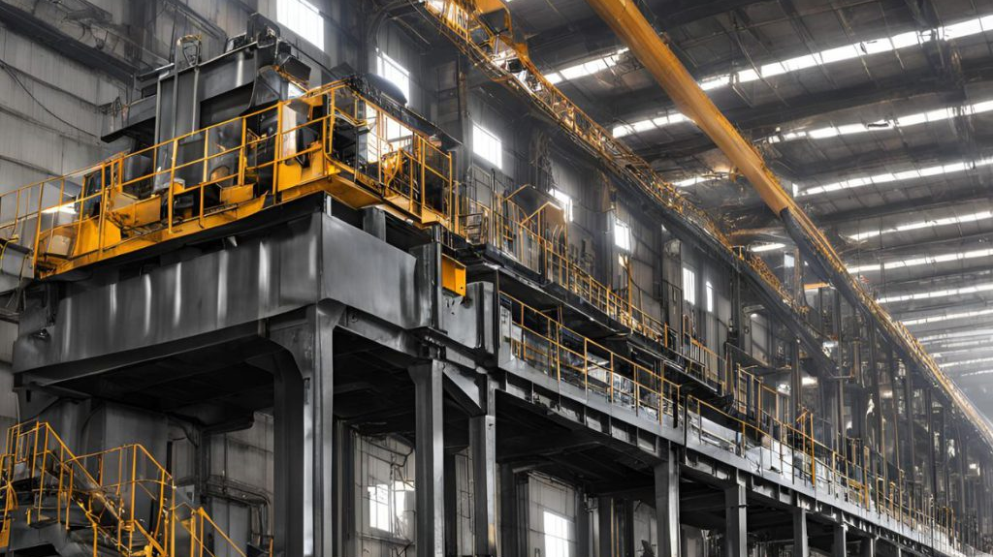

Slide 5
Executive Summary:
The dataset serves as a case study for our company, a steel manufacturing firm aiming to enhance product quality, reduce operational inefficiencies, and improve overall competitiveness in the industry.
Defect identification provides actionable insights that drive operational improvements, cost savings, and strategic growth. Utilizing this data for predictive analytics and integrating it into smart manufacturing systems allows businesses to exceed quality and sustainability goals, securing a competitive edge in the steel industry.
PN

Slide 6
Tables:
Plate Table
Box Dimensions Table
Fault Type Table
Index Table
Luminosity Table
Notes:
Plate Table (Contains information about the steel plate)
Fault Type (Contains information about presence of different types of faults)
Box Dimensions (As the name suggests, contains coordinate data, parameter and area of the bounding box)
Luminosity (Contains information about the luminosity of the detected fault)
Index (Contains metrics data related to the bounding box, luminosity and the faults)

Slide 7
Relationships:
Plate table has a 1-to-many relationship with Faulty Type table
Plate table has a 1-to-many relationship with Index table
Fault Type table has a 1-to-many relationship with Box Dimensions table
Fault Type table has a 1-to-many relationship with Luminosity table

Slide 8
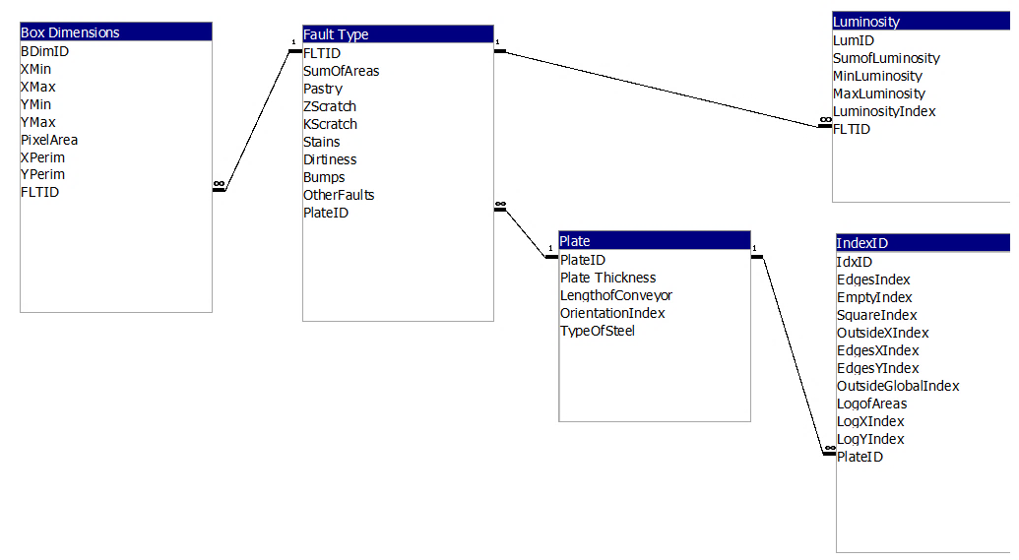
Entity Relationship Diagram

Slide 9
Queries:
Which plate type has the most faults
Which plate type has the most entries in IndexID
Which Fault has the most entries for BoxDim
Which Fault has the most entries for Luminosity
Show all the fault where luminosity is below this value
Show all the fault where luminosity is above this value
For this boxdim value, how many faults
Greater than this boxdim value, how many faults
Less than this boxdim value, how many faults
Greater than this luminosity value, how many faults
Less than this luminosity value, how many faults
Group the faulty by plate type

Slide 10
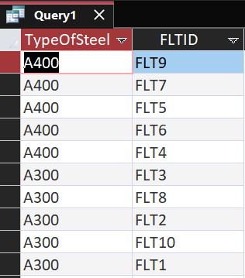
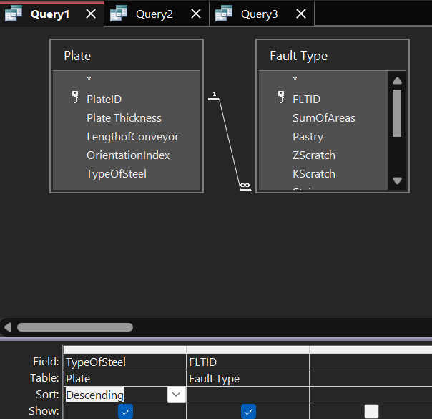
Query 1
Which plate type has the most faults?

Slide 11
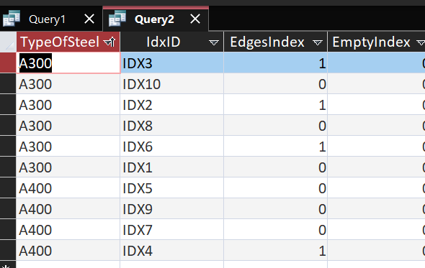
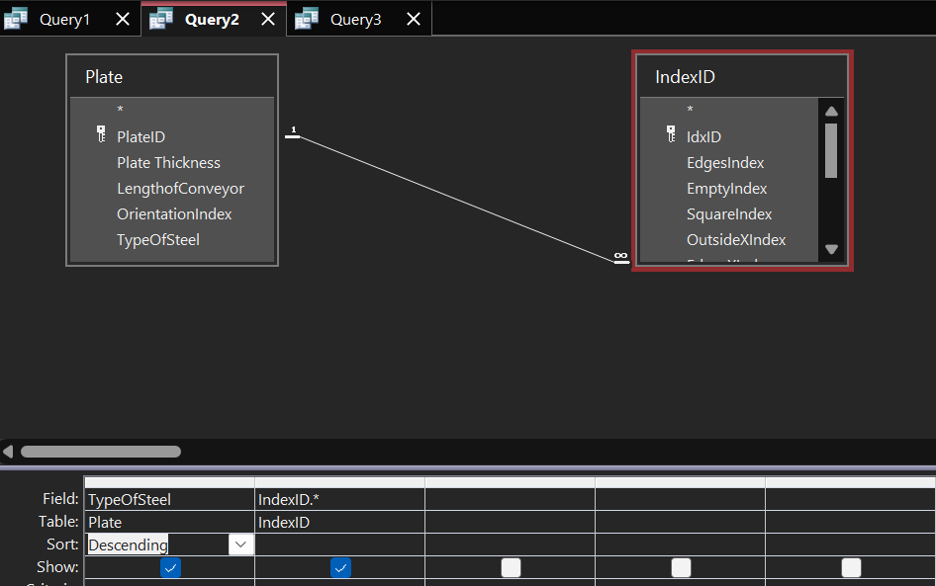
Query 2
Which plate type has the most entries in IndexID?

Slide 12
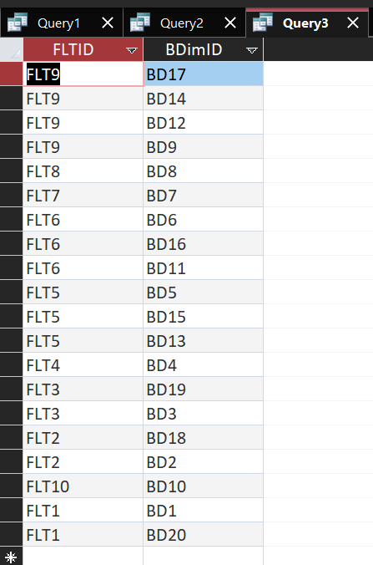
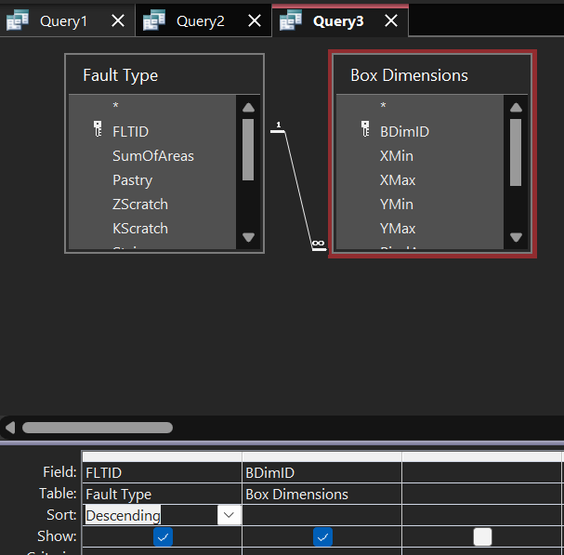
Query 3
Which Fault has the most entries for BoxDim

Slide 13
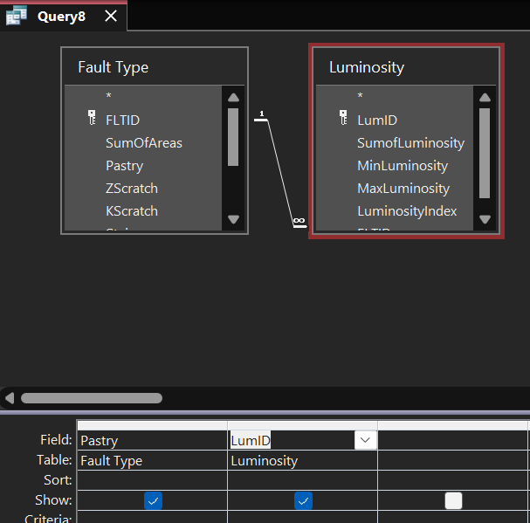
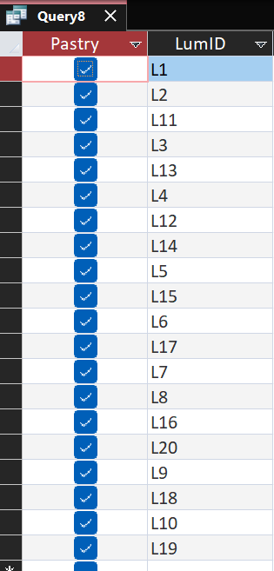
Query 4
For Pastry fault type, what are the entries for Luminosity?

Slide 14
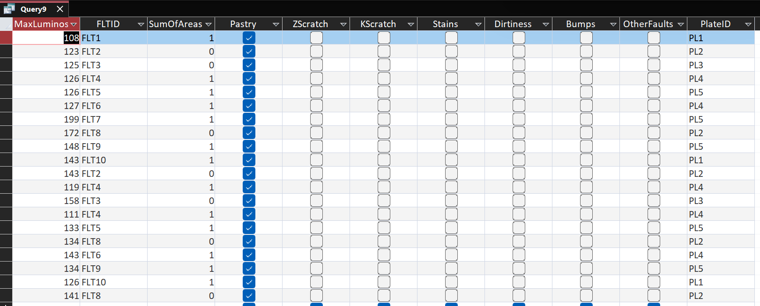
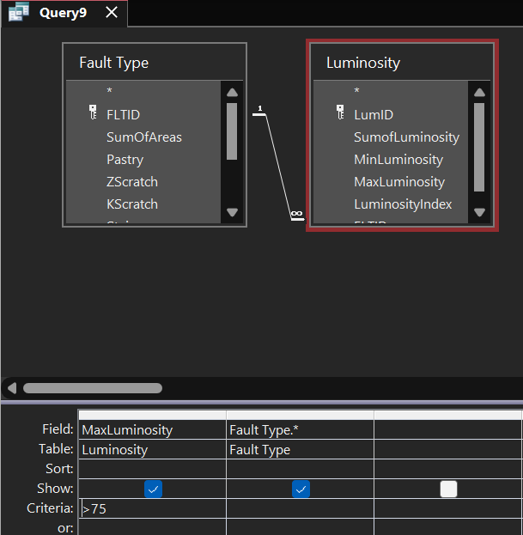
Query 5
Show all the fault where max luminosity is above 75

Slide 15
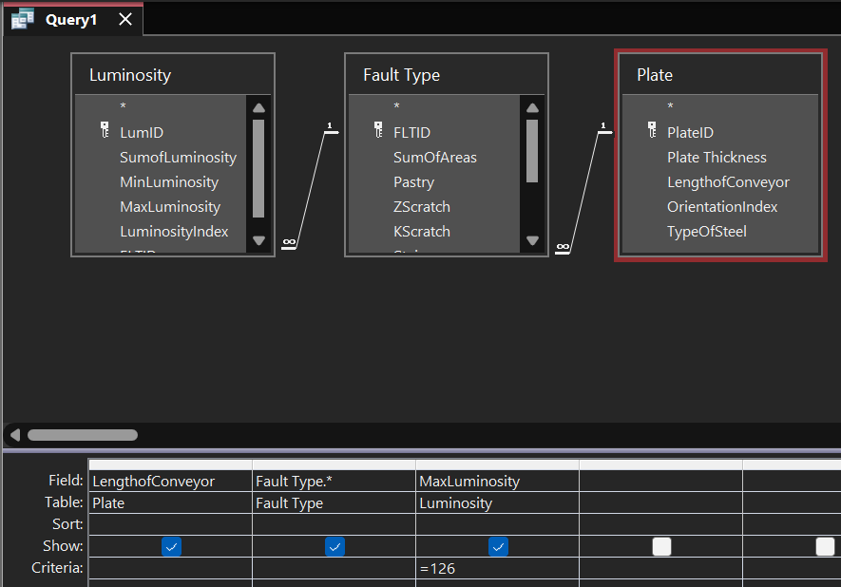
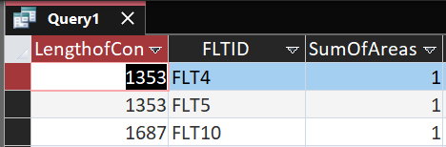
Query 6
LengthofConveyor for Max Luminosity 126

Slide 16
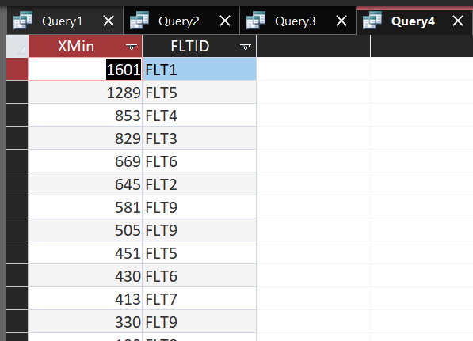
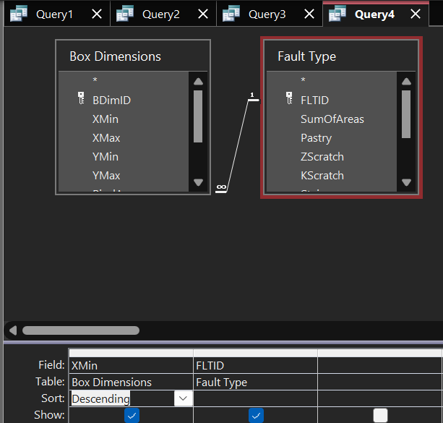
Query 7
For this boxdim value, how many faults?

Slide 17
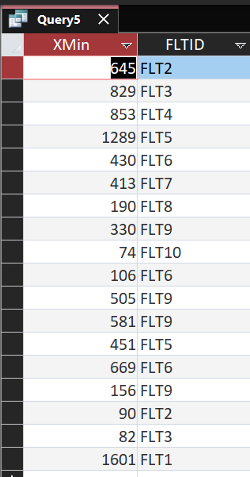
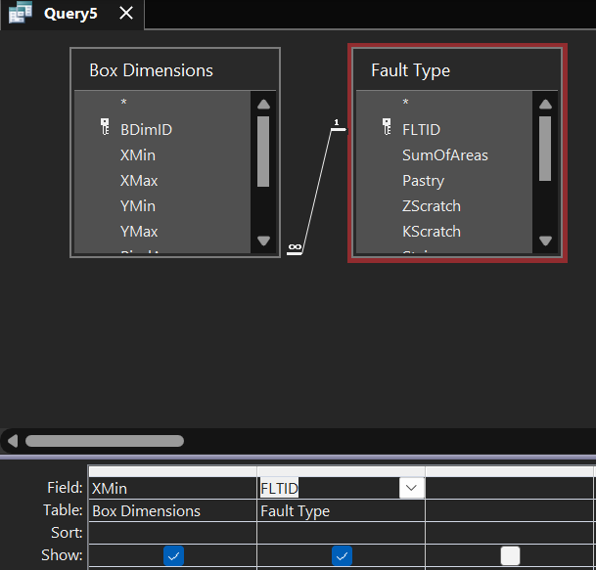
Query 8
Greater than 65 XMin value in Box Dim, how many faults?

Slide 18
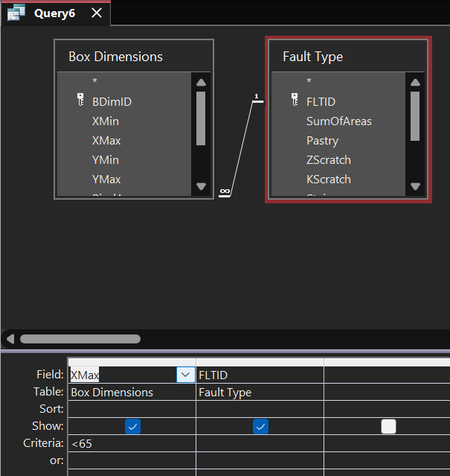
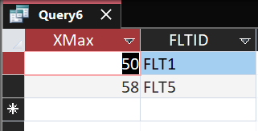
Query 9
Less than 65 XMax value, how many faults?

Slide 19
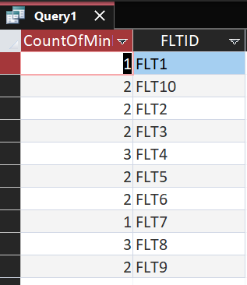
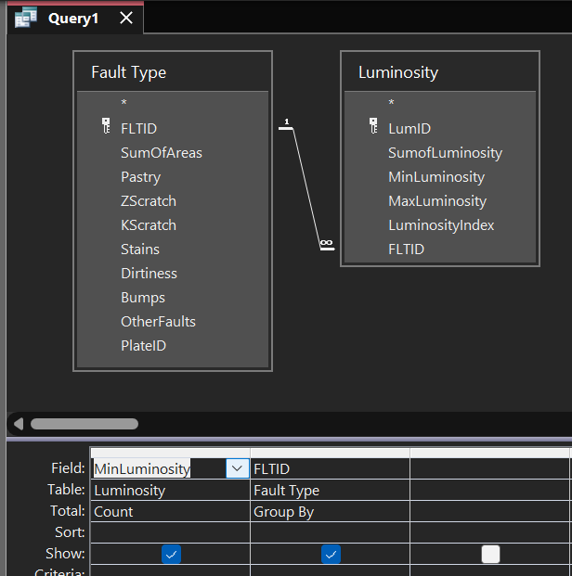
Query 10
Groupy FaultID by Min Luminosity

Slide 20
Query 11
Less than 65 XMax value, how many faults?

Slide 21
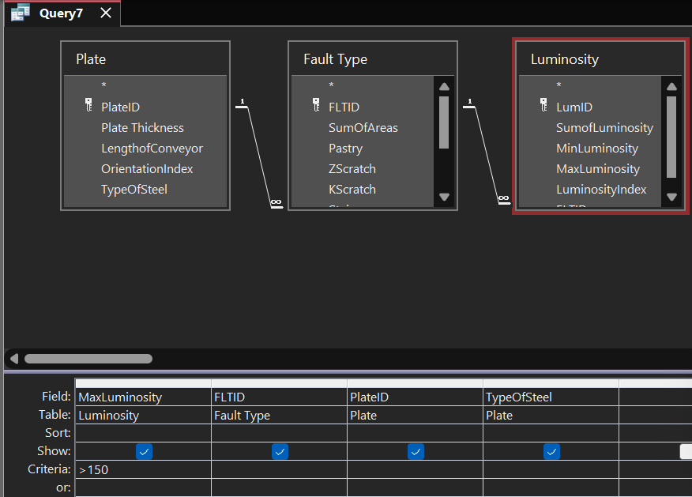
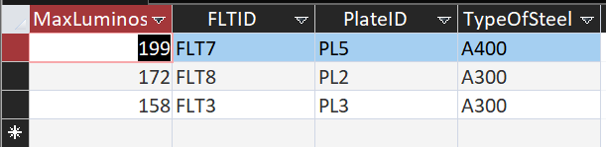
Query 12
Show the FaultID and PlateID and Type of Steel for Max Luminosity > 150

Slide 22
Queries with SQL

Slide 23
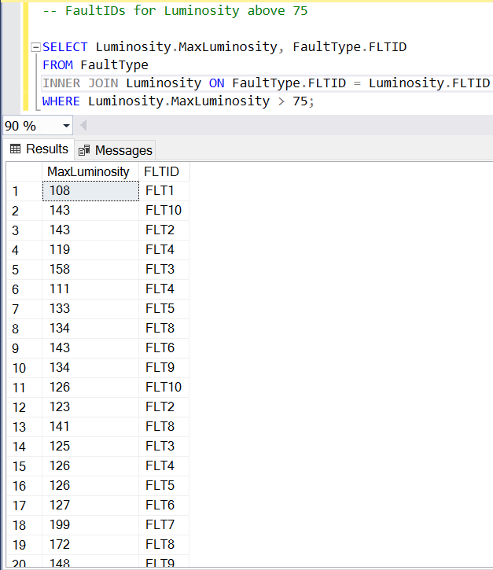
FaultIDs for Max Luminosity above 75

Slide 24
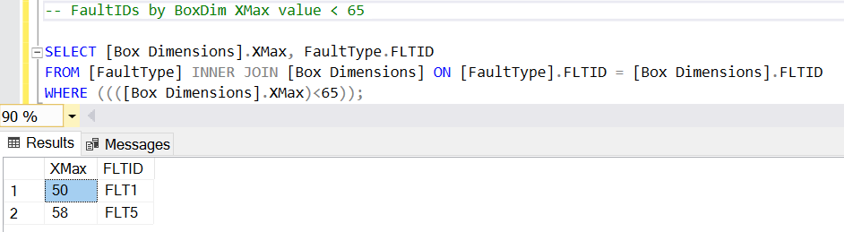
FaultIDs by BoxDim XMax Value < 65

Slide 25
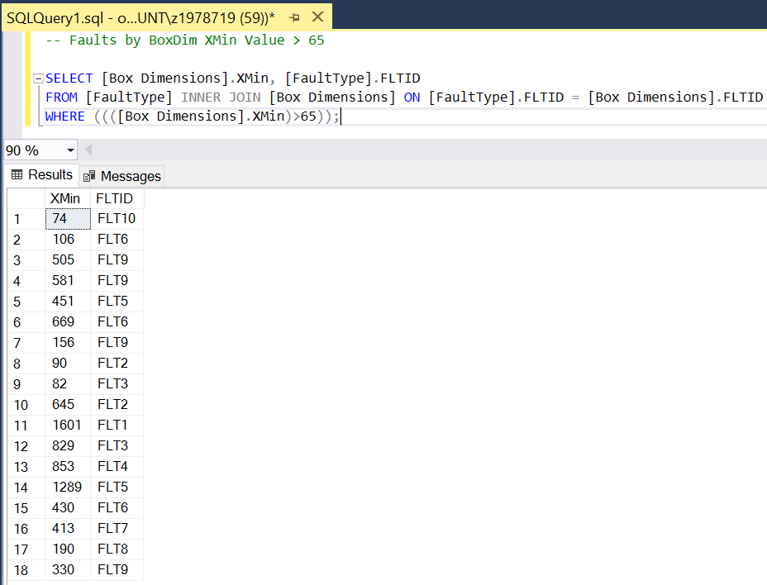
Faults by BoxDim XMin Value > 65

Slide 26
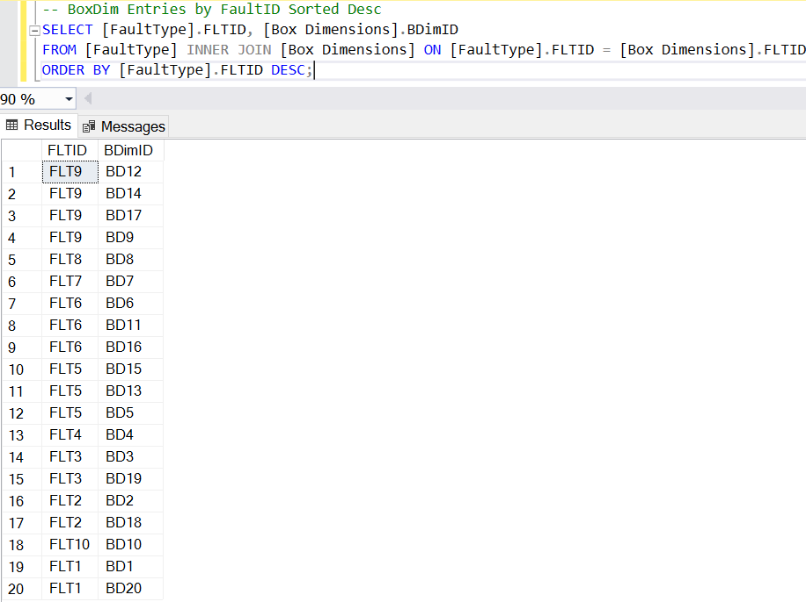
BoxDim Entries by FaultID Sorted Desc

Slide 27
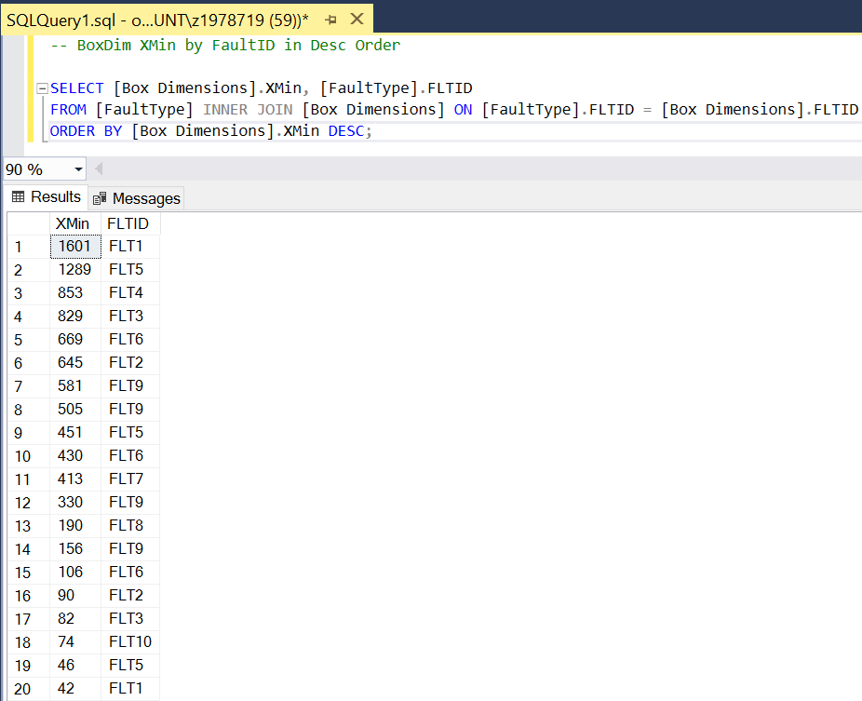
BoxDim XMin entries by FaultID in Desc

Slide 28
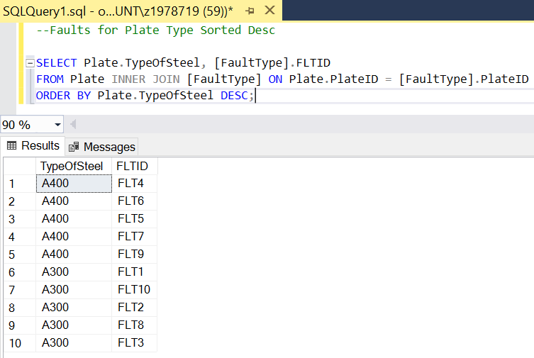
Faults for Plate Type Sorted Desc

Slide 29
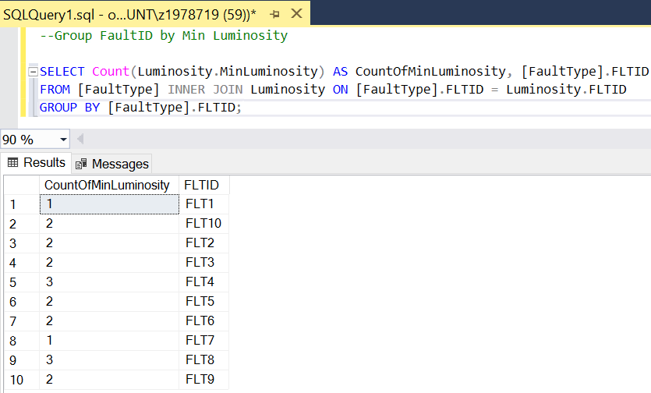
Group FaultID by Min Luminosity

Slide 30
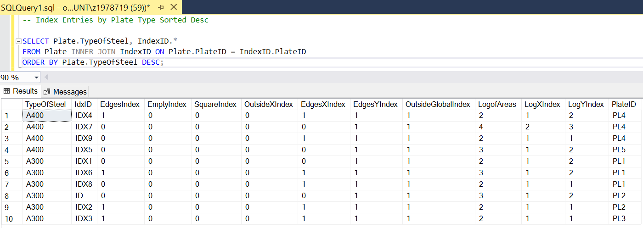
Index Entries by Plate Type Sorted Desc

Slide 31
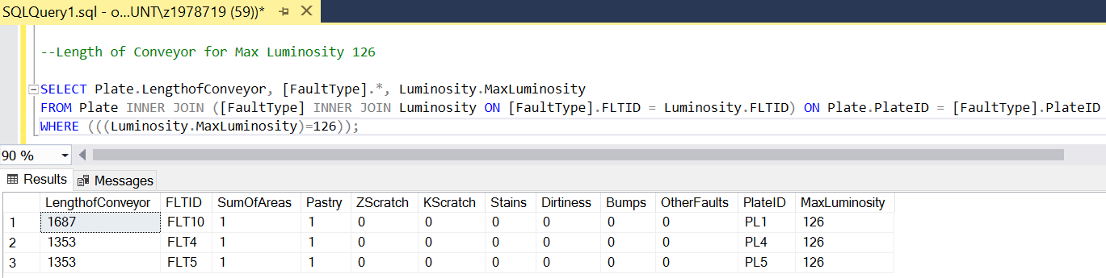
Length of Conveyor for Max Luminosity 126

Slide 32
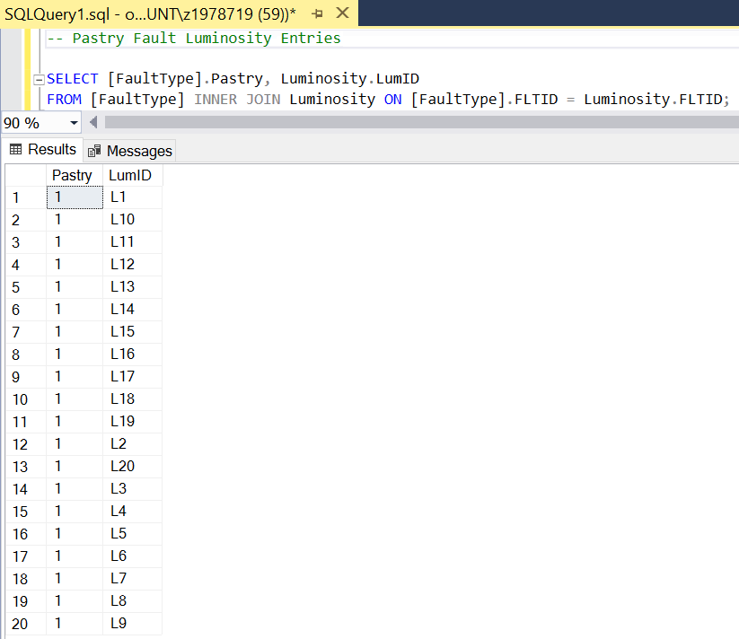
Pastry Fault Luminosity Entries

Slide 33
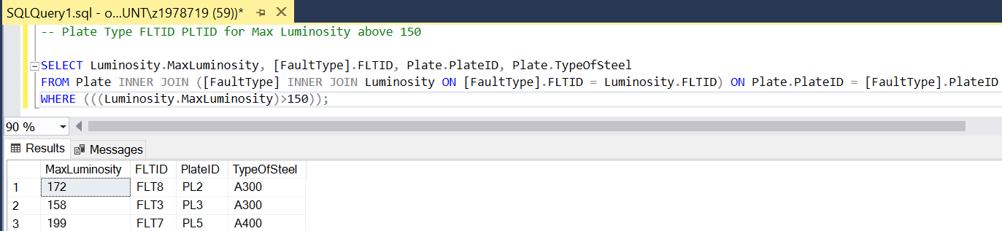
Plate Type FLTID PLTID for Max Luminosity above 150

Slide 34
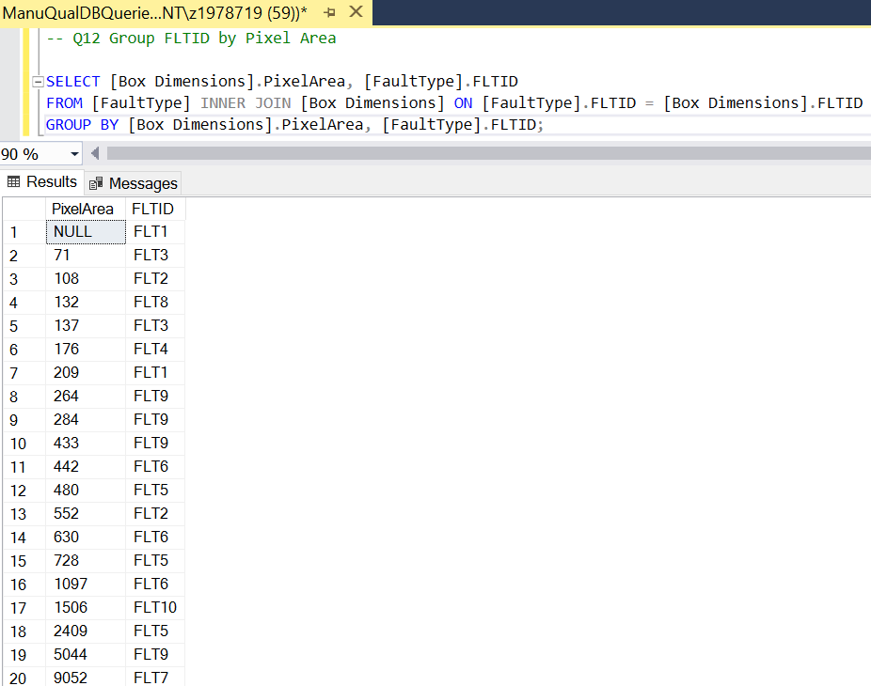
Group FLTID by Pixel Area

Slide 35
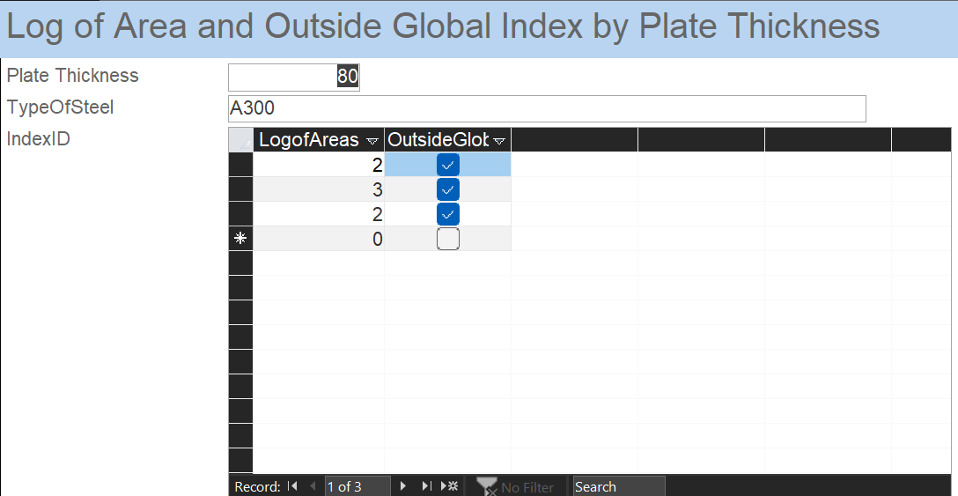
Form 1

Slide 36
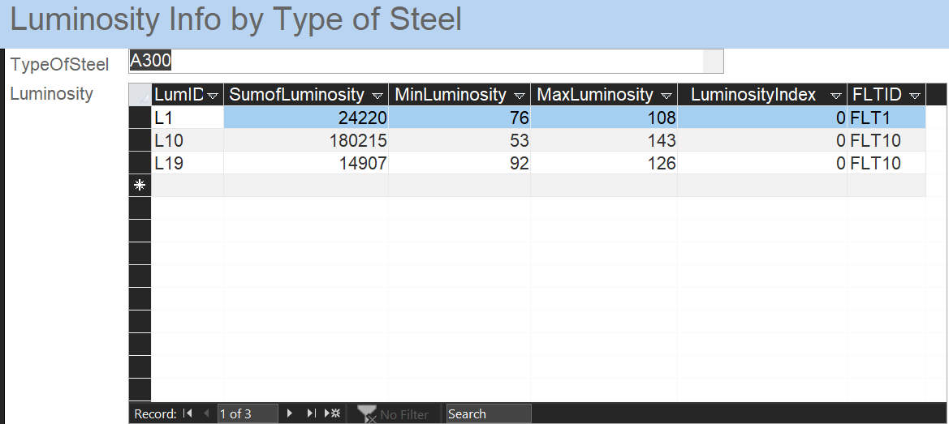
Form 2

Slide 37
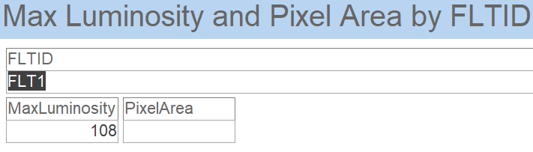
Form 3

Slide 38
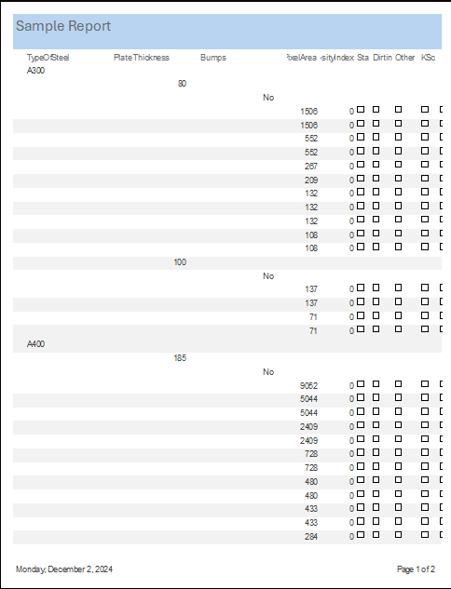
Sample Report

Slide 39
Risk Management Strategy:
Data Accuracy and Security
Implement validation protocols and secure systems to ensure reliable and protected data.
Operational Resilience
Monitor equipment in real-time and maintain contingency plans for downtime.
Technological Adaptability
Regularly update AI and IoT systems while auditing for seamless integration and security.
Supply Chain Stability
Diversify suppliers and trace defects to identify and address quality issues at the source.
PN

Slide 40
Future Improvements:
Enhanced Quality Control:
Data-driven insights enable our to proactively identify and mitigate defects, ensuring consistent steel quality.
Cost Optimization:
Early defect detection and predictive maintenance reduce material waste, operational inefficiencies, and unexpected downtime.
Strategic Growth:
Leveraging advanced technologies like AI and IoT enhances scalability and competitiveness, positioning the company as an industry leader.
Sustainability Alignment:
Minimizing production waste supports sustainability goals and strengthens the company’s brand image in an environmentally-conscious market.
Future Outlook:
Our company can expand these strategies across new facilities and products, achieving long-term operational and financial success.
PN

Slide 41
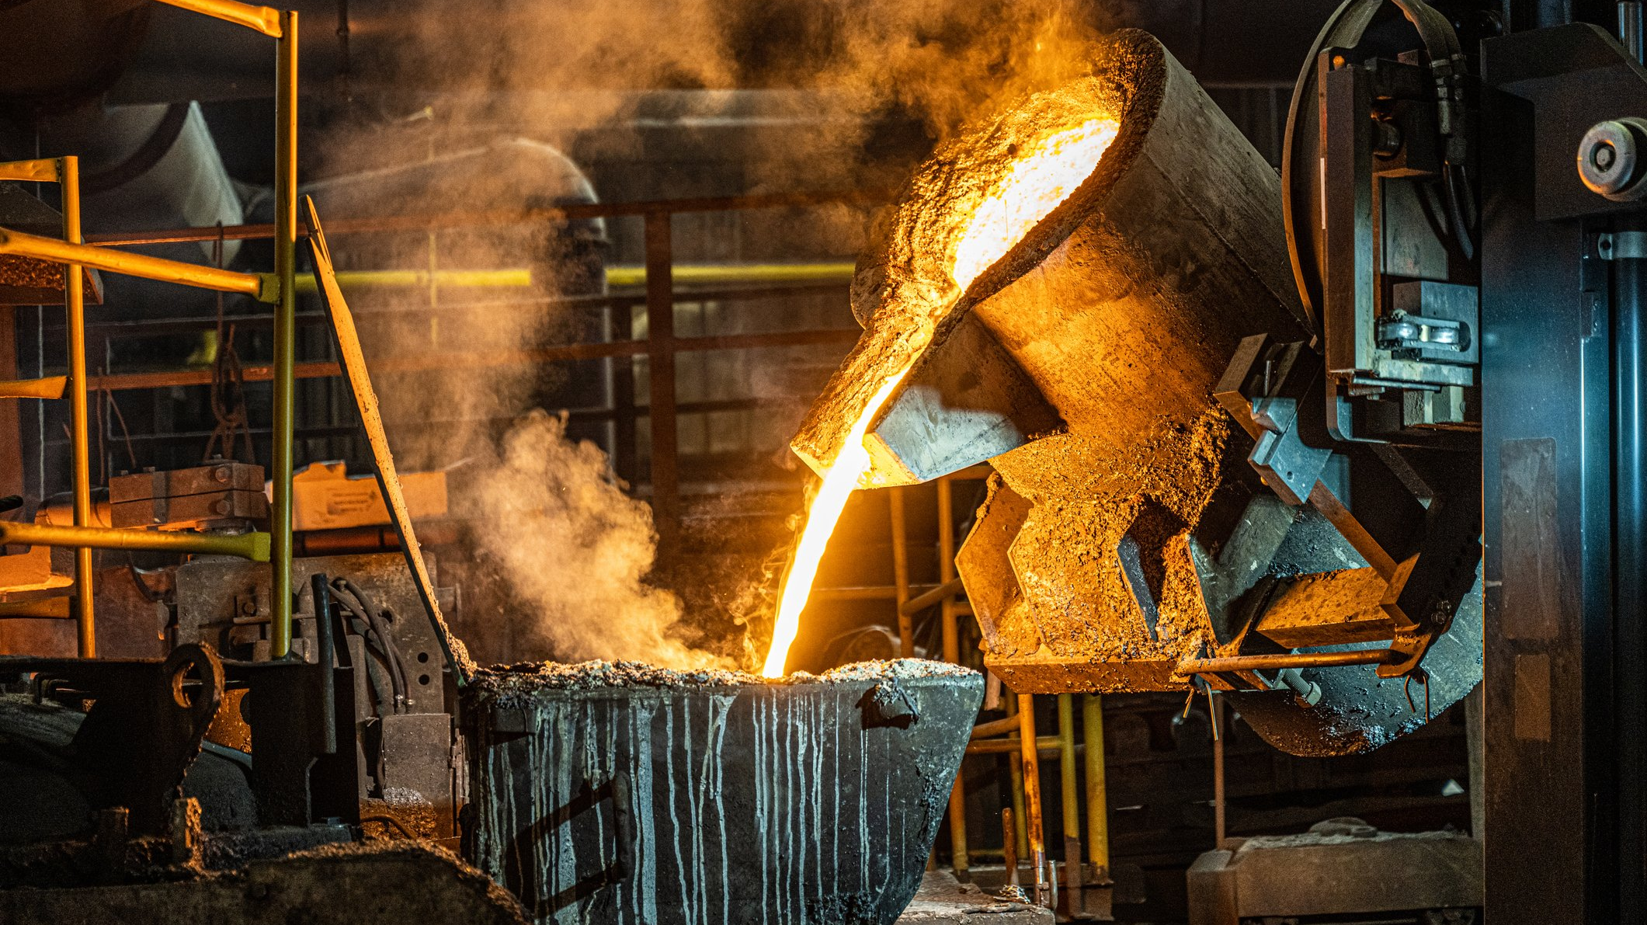
Thank you! Open for questions

